Slide 1
Artificial Intelligence for Games Week 9 – Indirect Learning 1 Steve Rabin
For help on projects, email everyone (select and copy this string from the start of any class PowerPoint):
steve.rabin@gmail.com, p.jiankai@digipen.edu, b.hsu@digipen.edu, zak.s@digipen.edu, keaton.sullivan@digipen.edu, john.tseng@digipen.edu, a.roulst@digipen.edu
TAs: Jian Kai Phua, Brandon Hsu, Zak Stephenson, Keaton Sullivan, John Tseng, Andrew Roulst

Slide 2
Questions
What is the Mind-Body Problem? Why is it important for the question of computer consciousness?
What is the Problem of Other Minds? Why is it important for the question of computer consciousness?
Searle’s Chinese Room was an argument against what?
Turing test
When will the intelligence explosion happen? Who made this prediction?
2099
According to “The A.I. Dilemma” video:
What was humanity’s “1st Contact with AI”?
(Social Media: Curation AI)
What is humanity’s “2nd Contact with AI”?
(Generative AI: Creation AI)
Notes:
5.

Slide 3
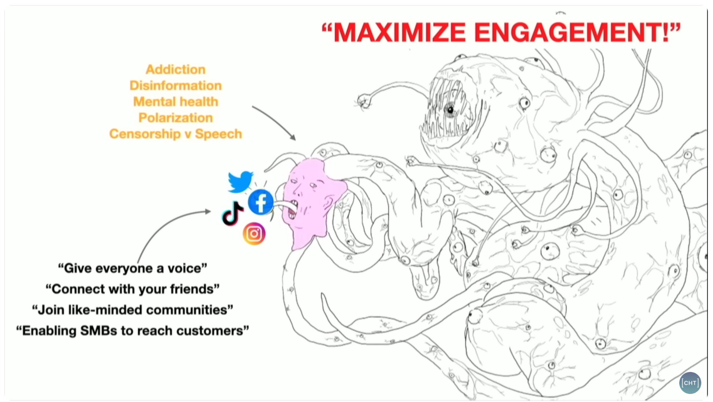

Slide 4
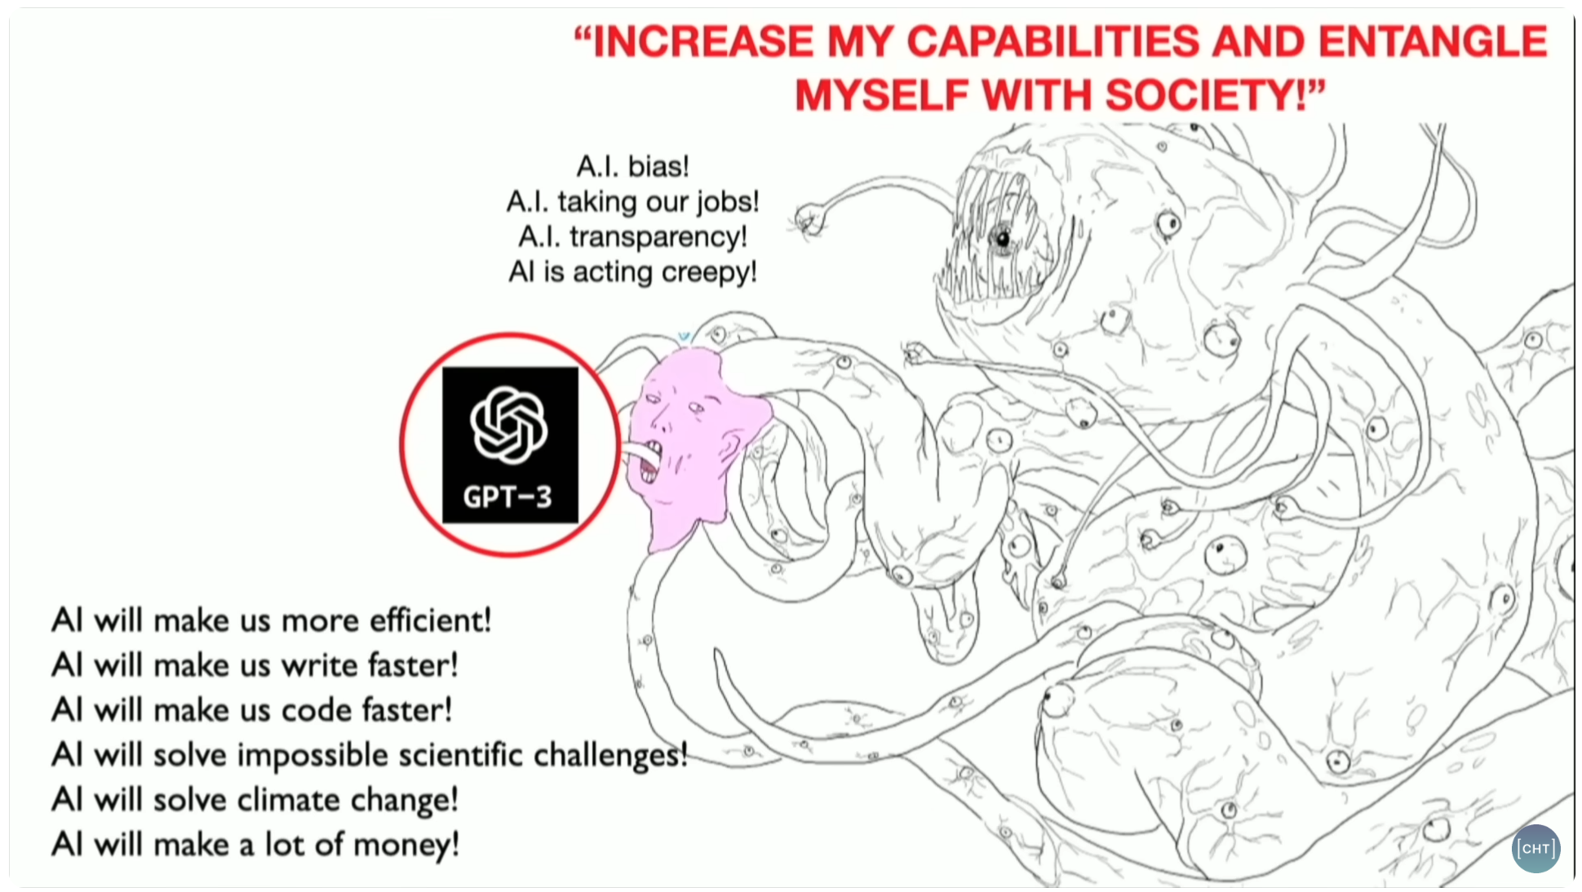

Slide 5
2 types of learning and adaptation
Indirect Adaptation
N-gram statistical prediction
Moving averages
Player modeling
Weakness modification learning
Direct Adaptation
Neural networks
Perceptrons
Decision tree learning
Genetic algorithms

Slide 6
Why would you want an AI agent that learns?

Slide 7
How would you fake learning?
…where no learning is actually happening…

Slide 8
How to fake agent learning
Strategy:
Purposely dumb down the AI in this respect
Gradually dial up the accuracy with time
Only works when:
You always know the correct answer
You can calculate the answer perfectly
Examples:
FPS – Aiming accuracy
FPS – Locating health/weapons
Fighters – Countering player's next move
RTS – Preparing for where the player will attack

Slide 9

Indirect Adaptation
Game collects player statistics
Adapts the AI in a preprogrammed way
RTS Example
If player’s first assault comes early in most games, AI should be ready for an early attack

Slide 10
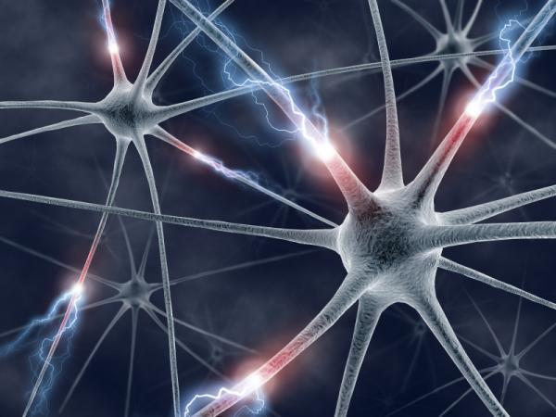
Direct Adaptation
AI is controlled by a set of parameters
Parameters are optimized directly and irreversibly
No model is constructed of the game world
Example
Neural network to control driving (steering/gas)

Slide 11
N-Gram Statistical Prediction

Slide 12
Complete the Sequence
18181818_
1811811818_
62562562162_
9876987_
12312341234512345_

Slide 13
N-Grams for Speech Recognition
Bi-Gram Model
blue ____
toy ____
Tri-Gram Model
go to _____
don’t know _____
Quad-Gram Model
how are you _____

Slide 14
N-Grams for Prediction
Player Sequence | Occurrences | Frequency
Low Kick, Low Punch, Uppercut | 10 times | 50%
Low Kick, Low Punch, Low Punch | 7 times | 35%
Low Kick, Low Punch, Sideswipe | 3 times | 15%

Slide 15
Predict the Next Move
Kick, Punch, Uppercut, Punch, Uppercut, Kick, Punch, Uppercut, Kick, Kick,
Punch, Punch, Kick, Uppercut, Uppercut, Kick, Punch, Punch, Kick, Punch
Uni-gram, Bi-Gram, Tri-Gram, Quad-Gram
Uni-gram: Punch (7 kick, 8 punch, 5 uppercut)
Bi-Gram: Uppercut (2 kick, 2 punch, 3 uppercut)
Tri-Gram: Punch, Uppercut (2 punch, 2 uppercut)
Quad-Gram: No evidence
Notes:
Bi – just look at the start word and whats next

Slide 16
Chance of an Uppercut?
Kick, Punch, Uppercut, Punch, Uppercut, Kick, Punch, Uppercut, Kick, Kick,
Punch, Punch, Kick, Uppercut, Uppercut, Kick, Punch, Punch, Kick, Punch
Uni-gram, Bi-Gram, Tri-Gram, Quad-Gram
Uni-gram: 5/20
Bi-Gram: 3/7
Tri-Gram: 2/4
Quad-Gram: 0

Slide 17
Predict the Next Move
Punch, Kick, Punch, Kick, Punch, Kick, Punch, Kick,
Punch, Kick, Punch, Kick, Uppercut, Punch, Kick,
Uppercut, Punch, Kick, Uppercut, Punch, Kick, Uppercut
Punch, Kick, Uppercut, Punch, Kick, Uppercut, Punch, Kick
Bi-Gram:
1st two lines: Bi-gram: 5 Punch, 1 Uppercut
2nd two lines: Bi-Gram: 0 Punch, 4 Uppercut
All four lines: Bi-Gram: 5 Punch, 6 Uppercut

Slide 18
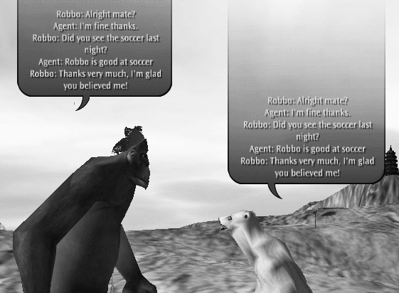
Black and White natural language learning

Slide 19
Natural Language Learning
MegaHAL:
I COULD SHAKE MY TINY FIST AND SWEAR I WASN'T WRONG, BUT WHAT'S THE SENSE IN ARGUING WHEN YOU'RE MUCH TOO BUSY RETURNING TO THE LAVATORY.
Direct question
User: Who is the smartest person in the world?
MegaHAL: A PERSON WITH A STICK OF CELERY UNDER HIS ARM?

Slide 20
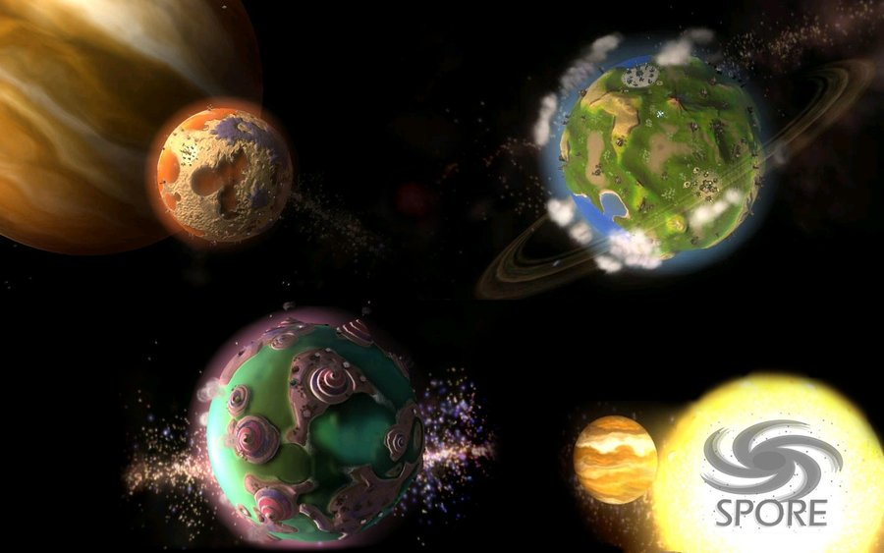
Naming in Spore
Database of names
Bi-gram statistics
Start with first 2 letters, grow name statistically
Used to create 1000s of names

Slide 21
Play SNL Video

Slide 22
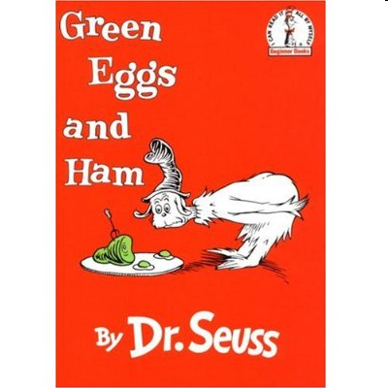
Green Eggs and Ham
Written in 1960
4th best selling children's book of all time
1991 SNL skit was when Dr. Seuss died
Green Eggs and Ham uses only 50 words
49 of them are single syllable words (anywhere)
$50 bet from publisher that Dr. Seuss couldn't write a book with only 50 words
Averages 5.7 words per sentence and 1.02 syllables per word, giving it an exceptionally low Flesch-Kincaid grade level of -1.3

Slide 23
Dr. Seuss Recombinator In-Class Activity

Slide 24
Recombinator Demo

Slide 25
Moving Averages

Slide 26
Moving Averages RTS: How many minutes before players attacks?

Slide 27
Moving Averages RTS: How many minutes before players attacks?
Sequence | Avg | Med
10

Slide 28
Moving Averages RTS: How many minutes before players attacks?
Sequence | Avg | Med
25 10

Slide 29
Moving Averages RTS: How many minutes before players attacks?
Sequence | Avg | Med
7 25 10

Slide 30
Moving Averages RTS: How many minutes before players attacks?
Sequence | Avg | Med
3 7 25 10

Slide 31
Moving Averages RTS: How many minutes before players attacks?
Sequence | Avg | Med
12 3 7 25 10

Slide 32
Moving Averages RTS: How many minutes before players attacks?
Sequence | Avg | Med
4 12 3 7 25 10

Slide 33
Moving Averages RTS: How many minutes before players attacks?
Sequence | Avg | Med
9 4 12 3 7 25 10

Slide 34
Moving Averages RTS: How many minutes before players attacks?
Sequence | Avg | Med
8 9 4 12 3 7 25 10

Slide 35
Moving Averages RTS: How many minutes before players attacks?
Sequence | Avg | Med
2 8 9 4 12 3 7 25 10

Slide 36
Moving Averages RTS: How many minutes before players attacks?
Sequence | Avg | Med
5 2 8 9 4 12 3 7 25 10

Slide 37
Moving Averages RTS: How many minutes before players attacks?
Sequence | Avg | Med
5 2 8 9 4 12 3 7 25 10 | 8.5

Slide 38
Moving Averages RTS: How many minutes before players attacks?
Sequence | Avg | Med
5 2 8 9 4 12 3 7 25 10 | 8.5 | 7.5

Slide 39
Moving Averages RTS: How many minutes before players attacks?
Sequence | Avg | Med
5 2 8 9 4 12 3 7 25 10 | 8.5 | 7.5
1 5 2 8 9 4 12 3 7 25 10 | 7.8 | 7.0

Slide 40
Moving Averages RTS: How many minutes before players attacks?
Sequence | Avg | Med
5 2 8 9 4 12 3 7 25 10 | 8.5 | 7.5
1 5 2 8 9 4 12 3 7 25 10 | 7.8 | 7.0
3 1 5 2 8 9 4 12 3 7 25 10 | 7.4 | 6.0

Slide 41

Moving Average Window RTS: How many minutes before players attacks?
Sequence | Avg | Med
5 2 8 9 4 12 3 7 25 10 | 8.5 | 7.5

Slide 42
Moving Average Window RTS: How many minutes before players attacks?
Sequence | Avg | Med
5 2 8 9 4 12 3 7 25 10 | 8.5 | 7.5
1 5 2 8 9 4 12 3 7 25 10 | 7.6 | 6.0

Slide 43
Moving Average Window RTS: How many minutes before players attacks?
Sequence | Avg | Med
5 2 8 9 4 12 3 7 25 10 | 8.5 | 7.5
1 5 2 8 9 4 12 3 7 25 10 | 7.6 | 6.0
3 1 5 2 8 9 4 12 3 7 25 10 | 5.4 | 4.5

Slide 44
Sequence | Avg | Med
5 2 8 9 4 12 3 7 25 10 | 8.5 | 7.5
1 5 2 8 9 4 12 3 7 25 10 | 7.8 | 7.0
3 1 5 2 8 9 4 12 3 7 25 10 | 7.4 | 6.0
Sequence (moving average window) | Avg | Med
5 2 8 9 4 12 3 7 25 10 | 8.5 | 7.5
1 5 2 8 9 4 12 3 7 25 10 | 7.6 | 6.0
3 1 5 2 8 9 4 12 3 7 25 10 | 5.4 | 4.5

Slide 45
Moving Average Equation
newAvg = α · newObservation + (1- α) · avg
α = Learning rate (usually equal to 1/n)
α = 0.05 if changes are common
α = 0.01 if changes are rare

Slide 46
Moving Average Equation
newAvg = α · newObservation + (1- α) · avg
α = 0.01 5.05 = 0.01 · 10.0 + (0.99) · 5.0
α = 0.10 5.50 = 0.10 · 10.0 + (0.90) · 5.0
α = 0.50 7.50 = 0.50 · 10.0 + (0.50) · 5.0

Slide 47

Detecting Changes
The player might change behavior
How do you detect this?
Have two moving average equations
Moving average window (10 observations)
Moving average window (20 observations)
Do they agree?

Slide 48
Estimating Extreme Values
Extreme values represent risk
Game designer:
“AI should be caught off-guard 1 out of 5 times”
3 8 1 4 9 13 5 7 6 4
1 3 4 4 5 6 7 8 9 13

Slide 49
Player Modeling

Slide 50

Player Modeling
Model the player’s behavior
Record frequency of actions
Use stats to make game harder or easier
Adapt to better counter player moves (harder)
Adapt to be more susceptible to player moves (easier)
Alternative: Manually set difficulty levels

Slide 51
Player Modeling
Record the player’s
Skills
Weaknesses
Preferences
Dislikes

Slide 52
Player Modeling
We call the recorded values traits
Traits are ideally in the range [0,1]

Slide 53
Brainstorm some RTS Traits
RTS traits
AvoidsMovingThroughEnemyChokepoints
AttacksOnTwoFronts
PrefersGroundForces

Slide 54
Brainstorm some FPS Traits
FPS traits
UsesSmokeGrenades
AlwaysRuns
CanDoTrickyJumps

Slide 55
Consider Trait Meanings
Trait: SmokeGrenades
Could mean:
Skill (skilled at using smoke grenades)
Preference (often uses smoke grenades)
Better names for each?

Slide 56
Fine Grained vs. Coarse
Fine grained is:
Costly to design and develop
Costly to compute
Lack of evidence
PrefersSmokeGrenades
GoodAtSmokeGrenades
Fine grained examples:
While retreating
While entering building
While covering teammate

Slide 57
Player Modeling Tips
Make a list of things to record about the player
Estimate collection difficulty
Estimate usefulness
Record stats that you want to show the player
Record stats that will be useful for the AI
If the AI is not designed yet:
Define player model and build strategies to exploit it

Slide 58
Player Modeling: How do you actually architect it?
Centralize the storage of traits
Notify storage when events happen
From the easiest places to observe
Might get messy…
Make query functions for the AI

Slide 59
Player Modeling Examples
Make the game harder
Use as predictive tool (skills)
If AI wants to attack player with a wizard, and player frequently kills wizards with a ranged attack, wizard could preemptively cast spell to protect against ranged attacks
Look for player weaknesses to exploit
If player lousy at defending against roundhouse kick, then pick that move more often
Look for player skills to defend against
If player always picks up health, try to starve them of it

Slide 60
Player Modeling Examples
Make the game easier
Avoid exploiting player weaknesses
If player never gets shield, don't get shield yourself
Can you make the game easier or harder knowing
Preferences?
Dislikes?

Slide 61
Hierarchical Player Models
Stealthy Trait (abstract)
Geometric Mean of
AvoidsCameras (concrete)
AvoidsGuards (concrete)
MovesSilently (concrete)
If “Stealthy Trait” high
Make guards more watchful

Slide 62
Other Uses for Player Modeling
Expose model to player
Becomes part of gameplay (Fable)
Player manipulates the model
Help the player by pointing out things they aren’t doing/exploiting
Fancy AI help system

